Slide 1
Dangling DNS Kyle Phillips JUNE 2024

Slide 2
Overview
What is DNS?
What is dangling DNS?
Security implications
Research
Results

Slide 3
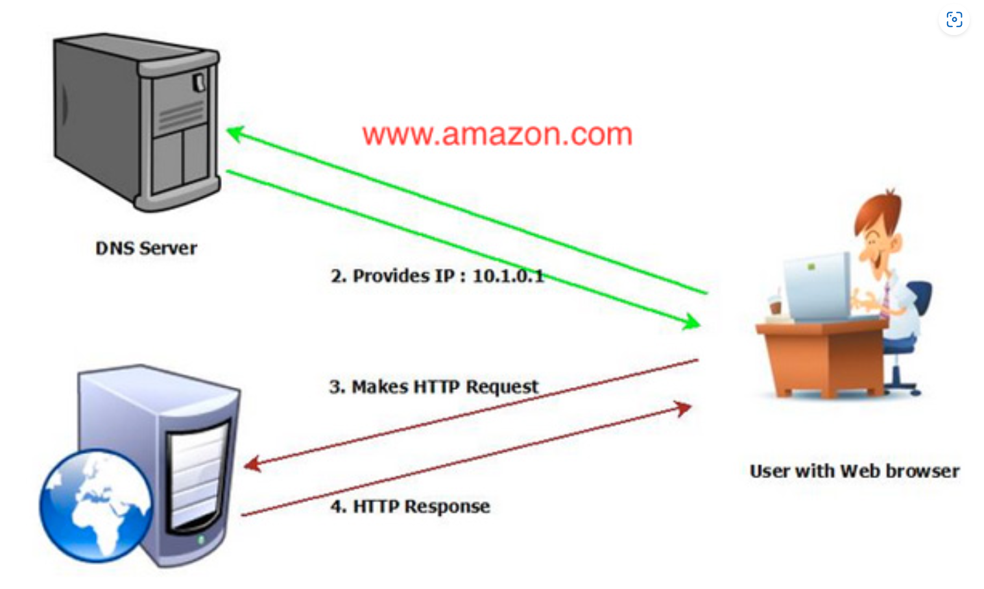
What is dns?
Phonebook of the internet: Match domain names to IP addresses
Notes:
Phone book to the internet. As website owners, it’s our responsibility to set up our DNS records so that when our website visitors go to our domain… the internet knows how to translate it to an IP address.

Slide 4
The Problem: DANGLING DNS
Abandoned DNS
Resource no longer available – decommission
Domain expires
DNS record – stays intact

Slide 5
The Problem
Security Threat
IP address may no longer be under your control
Trusted domain that can be abused by bad actors
Distribute malware
Phishing site
DNS mail (MX) records can be taken over
Reputational damage

Slide 6
The Problem
Examples
Digital marketing platform Mailer Lite was the victim of a phishing attack that resulted in the loss of over $600,000
Threat actor took over abandoned DNS record enabling them to send email as “msn.com”
Government site (UK) taken over to serve pornographic material
In 2020, a threat actor took over “code.Microsoft.com” (abandoned) to spoof Microsoft updates.
Security research firms says 15,000 abandoned DNS records per month for cloud services.
Notes:
Only 2% of organizations notified actually fix their DNS

Slide 7
STEP 1: Discover domains
Search (Google)
Search (Internet Archive)
Search (email listed on website)

Slide 8
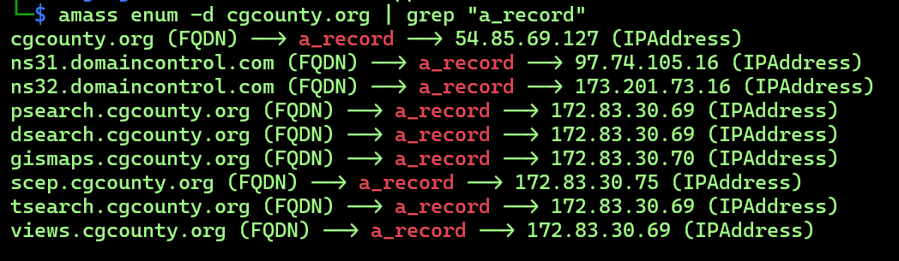
STEP 2: Domain enumeration
amass (Linux tool)
amass enum –d cgcounty.org
Sample output

Slide 9
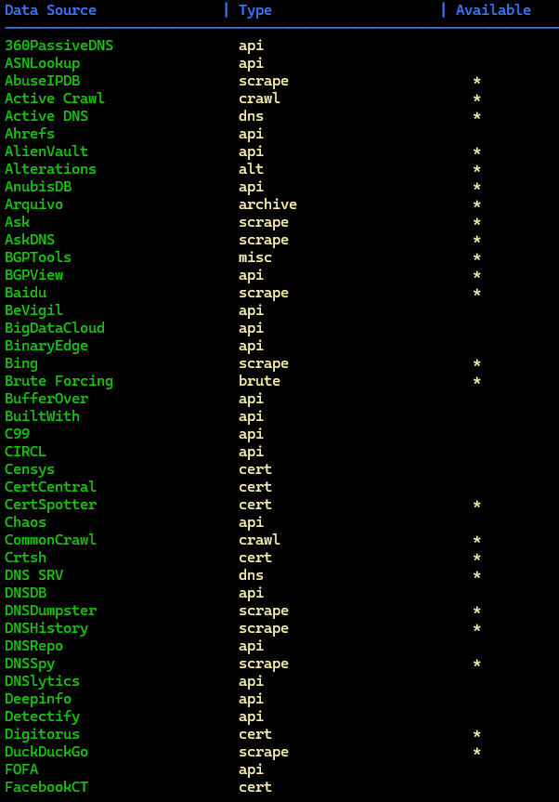
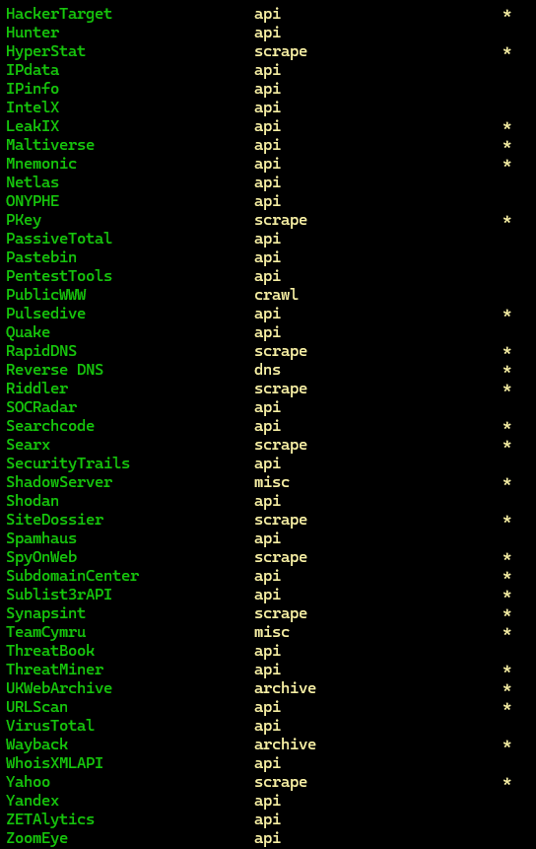

Slide 10
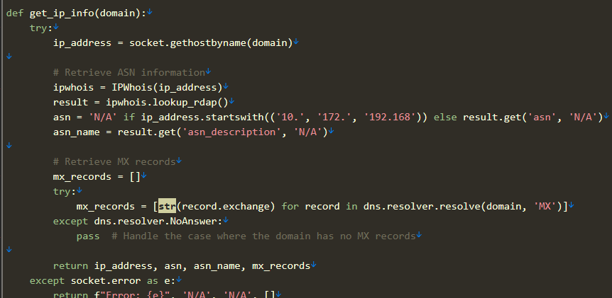
STEP 3: Iterate all discovered domains for http/s response
Python script
IP addresses
Service Provider (ASN)
HTTP response
HTTPS response
MX record (yes or no)

Slide 11
Actions you can take
Keep DNS records in your inventory
Include DNS in your decommissioning process
Audit DNS records annually
Review all record types (MX, SPF, CNAME, DMARC, etc)

Slide 12

Thank you
Kyle Phillips
https://www.linkedin.com/in/kyle-phillips-iowa/
https://github.com/kyle-phillips

